Slide 1
OVERVIEW
Home
Setup & Maintenance
Configuration & Reports
Customization
Tax Calculation & Location
Mapping Tools
Company
Batch Test
Access Tools
Reporting Tools
Employee Groups
What-If -Test
Database Tools
Address Override
Maintenance Tools
Pension What if Test
Configuration
Tax Effective Date Override
Custom Payments
Tax Locator
Custom Garnishments
Message Viewer
Garnishment Groups
Custom Tax Codes

Slide 2
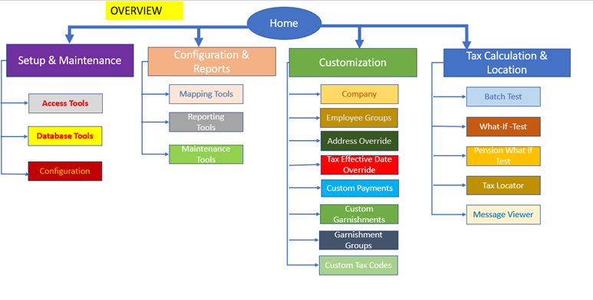
Home
Set Up & Maintenance
Database Tools
Access Tools
Configuration
Custom Backup/Restore-
Datasets
General Config On/Off
Custom Backup/Restore status-
Favorite Links
Optional/Unemployment Rate Override Backup
No. of Datasets defined
Optional/Unemployment Rate Override Backup status
No. of log ins defined
Database Load
Audit log viewer
Database Load Status
Install Machine key
Please Note: The links within the dotted
shapes do not display for TF SaaS

Slide 3
Home
Configuration & Reports
Maintenance Tools
Reporting Tools
Mapping Tools
Regulatory Bulletin level
Quick Formulas
Tax Codes
Tax Locator Level
Tax Details
Tax Types
Cyclic Level
User Data
Payment Codes
Manual update
Manual Update Status

Slide 4
Home
Customization
Company
Employee Groups
Custom Garnishments
Custom Tax Codes
Garnishment Groups
Custom Payments
Worksites
Disposable Override
Disposable Override
Custom Payment Exceptions
Custom Formula
Optional Rate Overrides
Payment Override
Custom Tax Payment Override
Garnishment Formula Override
Unemployment Overrides
Group Override
Custom Garnishment Formula
Reciprocal Override
Custom nexus Data

Slide 5

Home
Customization
Configuration & Reports
Custom Garnishments
Custom Payments
Mapping Tools
Company
Employee Groups
Custom Tax Codes
Garnishment Groups
Disposable Override
Disposable Override
Payment Codes
Worksites
Custom Formula
Custom Payment Exceptions
Garnishment Formula Override
Tax Types
Payment Override
Custom Tax Payment Override
Optional Rate Overrides
Tax Codes
Unemployment Overrides
Group Override
Custom Garnishment Formula
Custom nexus Data
Secondary dependencies

Slide 6
Home
RELATED ACTIVITIES
Customization
Configuration & Reports
Custom Garnishments
Custom Payments
Mapping Tools
Company
Employee Groups
Custom Tax Codes
Garnishment Groups
Disposable Override
Disposable Override
Payment Codes
Worksites
Custom Formula
Custom Payment Exceptions
Garnishment Formula Override
Tax Types
Payment Override
Custom Tax Payment Override
Optional Rate Overrides
Tax Codes
Unemployment Overrides
Group Override
Custom Garnishment Formula
Custom nexus Data
Secondary dependencies

Slide 7
Home
Tax Calculation & Location
Batch Test
What-If -Test
Pension What if
Tax Locator
Message Viewer

